Slide 1
BITS Pilani presentation
Yogesh B
Introduction to DevOps

Slide 2
CSIZG514/SEZG514, Introduction to DevOps
Lecture No. 1

Slide 3
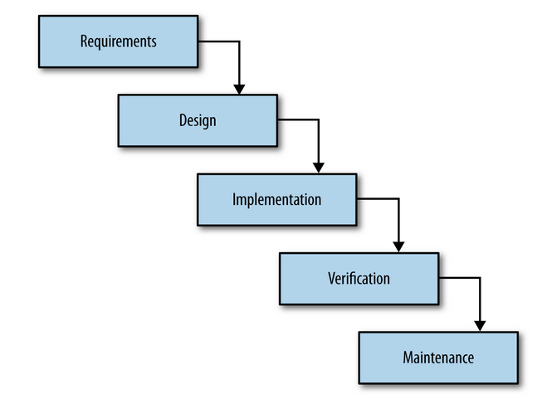
Waterfall

Slide 4
Pros of Waterfall
Cons of Waterfall

Slide 5
Agile
individuals and interactions over processes and tools
working software over comprehensive documentation
customer collaboration over contract negotiation
responding to change over following a plan

Slide 6
Scrum
Scrum
In the mid-1990s, Ken Schwaber and Dr. Jeff Sutherland, two of the original creators of the Agile Manifesto, merged individual efforts to present a new software development process called Scrum. Scrum is a software development methodology that focuses on maximizing a development team’s ability to quickly respond to changes in both project and customer requirements. It uses predefined development cycles called sprints, usually between one week and one month long, beginning with a sprint planning meeting to define goals and ending with a sprint review and sprint retrospective to discuss progress and any issues that arose during that sprint.

Slide 7
DSM
What did I do yesterday that helped the team meet its sprint goals?
What am I planning to do today to help the team meet those goals?
What, if anything, do I see that is blocking either me or the team from reaching their goals?

Slide 8
Version Control
A version control system records changes to files or sets of files stored within the system. This can be source code, assets, and other documents that may be part of a software development project. Developers make changes in groups called commits or revisions. Each revision, along with metadata such as who made the change and when, is stored within the system in one way or another.
Having the ability to commit, compare, merge, and restore past revisions to objects to the repository allows for richer cooperation and collaboration within and between teams. It minimizes risks by establishing a way to revert objects in production to previous versions.

Slide 9
Test Driven Development
In test-driven development, the code developer starts by writing a failing test for the new code functionality, then writes the code itself, and finally ensures that the test passes when the code is complete. The test is a way of defining the new functionality clearly, making more explicit what the code should be doing.
Having developers write these tests themselves not only greatly shortens feedback loops but also encourages developers to take more responsibility for the quality of the code they are writing. This sharing of responsibility and shorter development cycle time are themes that continue to be important parts of a devops culture.

Slide 10
Continuous Integration
Continuous integration (CI) is the process of integrating new code written by developers with a mainline or “master” branch frequently throughout the day. This is in contrast to having developers working on independent feature branches for weeks or months at a time, merging their code back to the master branch only when it is completely finished. Long periods of time in between merges means that much more has been changed, increasing the likelihood of some of those changes being breaking ones. With bigger changesets, it is much more difficult to isolate and identify what caused something to break. With small, frequently merged changesets, finding the specific change that caused a regression is much easier. The goal is to avoid the kinds of integration problems that come from large, infrequent merges.

Slide 11
Continuos Delivery
Continuous delivery (CD) is a set of general software engineering principles that allow for frequent releases of new software through the use of automated testing and continuous integration. It is closely related to CI, and is often thought of as taking CI one step further, that beyond simply making sure that new changes can be integrated without causing regressions to automated tests, continuous delivery means that these changes can be deployed.

Slide 12
Continuos Deployment
Continuous deployment (also referred to as CD) is the process of deploying changes to production by defining tests and validations to minimize risk. While continuous delivery makes sure that new changes can be deployed, continuous deployment means that they get deployed into production.

Slide 13

Deployment Pipeline
The pattern that is central to this book is the deployment pipeline. A deployment pipeline is, in essence, an automated implementation of your application’s build, deploy, test, and release process. Every organization will have differences in the implementation of their deployment pipelines, depending on their value stream for releasing software, but the principles that govern them do not vary. An example of a deployment pipeline is given in Figure

Slide 14
Antipattern: Deploying Software Manually
The signs of this antipattern are:
• The production of extensive, detailed documentation that describes the steps to be taken and the ways in which the steps may go wrong
• Reliance on manual testing to confirm that the application is running correctly
• Frequent calls to the development team to explain why a deployment is going wrong on a release day
• Frequent corrections to the release process during the course of a release

Slide 15
Antipattern: Deploying to a Production-like Environment Only after Development Is Complete
If testers have been involved in the process up to this point, they have tested the system on development machines.
• Releasing into staging is the first time that operations people interact with the new release. In some organizations, separate operations teams are used to deploy the software into staging and production. In this case, the first time an operations person sees the software is the day it is released into production.
• Either a production-like environment is expensive enough that access to it is strictly controlled, or it is not in place on time, or nobody bothered to create one.
• The development team assembles the correct installers, configuration files, database migrations, and deployment documentation to pass to the people who perform the actual deployment—all of it untested in an environment that looks like production or staging.

Slide 16
Every Change Should Trigger the Feedback Process
Executable code changes when a change is made to the source code. Every time a change is made to the source code, the resulting binary must be built and tested. In order to gain control over this process, building and testing the binary should be automated. The practice of building and testing your application on every check-in is known as continuous integratio

Slide 17
The Feedback Must Be Received as Soon as Possible
They run fast.
• They are as comprehensive as possible—that is to say, they cover more than 75% or so of the codebase, so that when they pass, we have a good level of confidence that the application works.
• If any of them fails, it means our application has a critical fault and should not be released under any circumstances. That means that a test to check the color of a UI element should not be included in this set of tests.
• They are as environment-neutral as possible—that is, the environment does not have to be an exact replica of production, which means it can be simpler and cheaper.
On the other hand, the tests in the later stages have the following general characteristics.

Slide 18
Thank You!
Acknowledgement:
Significant portions of the information in the presentation is from IT Systems Management - Rich Schiesser and other books/Internet. Permission was requested from the publisher, sometime ago for use, but has not been received as yet. This is intended solely to teach BITS students enrolled for IM. I would like to acknowledge and reiterate that all the credit/rights remain with the original authors/publishers only. Mistakes if any are mine.

